Slide 1
Olist E-Commerce Sales Report
Data Analytics Approach by Morakinyo

Slide 2
AGENDA:
Introduction
Background
Data Exploration
Data Visualization and Interpretation
Recommendations

Slide 3
Introduction:
The Olist sales dataset provides a unique opportunity to gain insights into the e-commerce industry in Brazil, one of the fastest-growing and most dynamic e-commerce markets in the world. The dataset covers orders placed on the Olist platform between January 2017 and August 2018, and includes a wide range of information about customer behavior, seller performance, product details, payment and shipping information, customer demographics, and reviews.
This data analysis report aims to explore and analyze the Olist sales dataset to identify trends, patterns, and opportunities for growth and optimization. By analyzing the dataset, we can gain insights into the performance of the Olist platform and its sellers, as well as the behavior and preferences of Brazilian e-commerce customers.

Slide 4
Background:
E-commerce in Brazil has experienced significant growth in recent years, driven by increasing internet and smartphone penetration, rising consumer confidence, and a growing middle class. According to Statista, Brazil's e-commerce market was valued at approximately 20 billion USD in 2019 and is projected to reach 27 billion USD by 2021. E-commerce sales are expected to continue to grow at a rapid pace, driven by the increasing adoption of online shopping by Brazilian consumers.
Olist is one of the leading e-commerce marketplaces in Brazil, providing a platform for small and medium-sized businesses to connect with customers across the country. The platform currently has over 7,000 sellers and offers more than 2 million products across

Slide 5
Data Exploration
We began the data exploration of the Olist sales dataset by reviewing the data for quality issues such as incorrect data types and null values. We corrected the incorrect data types and filled null values to ensure the dataset was accurate and reliable for analysis.
Next, we analyzed the data using Pandas in a Jupyter Notebook, exploring customer, geography, items, payments, reviews, orders, sellers, product names, and products datasets. Through the exploration, we gained insights into demographics, regional variations, payment and shipping methods, and product Categories.
The findings from the data exploration will be used to inform subsequent analysis and recommendations for optimizing the Olist platform.

Slide 6
Data Visualization and Interpretation
To gain further insights into the Olist e-commerce platform and identify opportunities for growth, we used Power BI analytics tool to visualize the data through various charts, graphs, and tables. Our visualizations allowed us to identify patterns and trends that would have been difficult to identify through data exploration alone.
We used visualization to answer the following business questions:
1: What is the total revenue generated by Olist, and how has it changed over time?
2: How many orders were placed on Olist, and how does this vary by month or season?
3: What are the most popular product categories on Olist, and how do their sales volumes compare to each other?
4: What is the average order value (AOV) on Olist, and how does this vary by product category or payment method?
5: How many sellers are active on Olist, and how does this number change over time?

Slide 7
Data Visualization and Interpretation
6: What is the distribution of seller ratings on Olist, and how does this impact sales performance?
7: How many customers have made repeat purchases on Olist, and what percentage of total sales do they account for?
8: What is the average customer rating for products sold on Olist, and how does this impact sales performance?
9: What is the average order cancellation rate on Olist, and how does this impact seller performance?
10: What are the top-selling products on Olist, and how have their sales trends changed over time?
11: Which payment methods are most commonly used by Olist customers, and how does this vary by product category or geographic region?
12: How do customer reviews and ratings affect sales and product performance on Olist?
13: Which product categories have the highest profit margins on Olist, and how can the company increase profitability across different categories?
14: How does Olist's marketing spend and channel mix impact sales and customer acquisition costs, and how can the company optimize its marketing strategy to increase ROI?
15: Geolocation having high customer density. Calculate customer retention rate according to geolocations

Slide 8
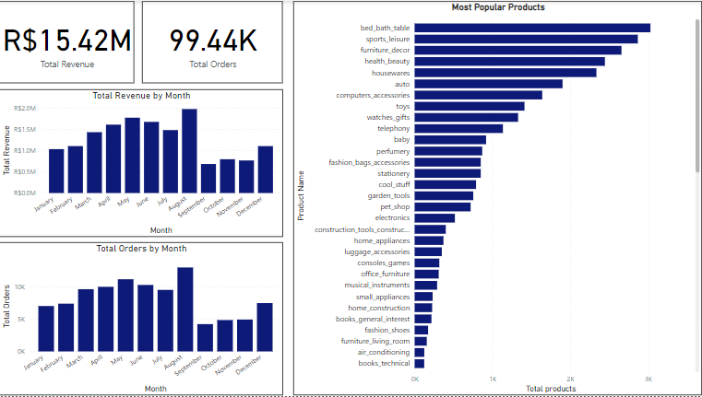
INSIGHTS
Upon analyzing the Olist e-commerce dataset from 2016 to 2018 using the Power BI analytics tool, the following insights were gained:
Olist generated a total revenue of approximately 15.42 million Reals, with revenue growing steadily from January until it peaked in August, before facing a decline in September, and picking up again in December.
A total of 99.44 thousand orders were placed on Olist, with orders growing steadily from January, peaking in August, declining rapidly in September, and picking up again in December.
The Bed_bath_table, sports_leisure, and furniture_decor were the most popular product categories on Olist, with bed_bath_table having the most orders.

Slide 9
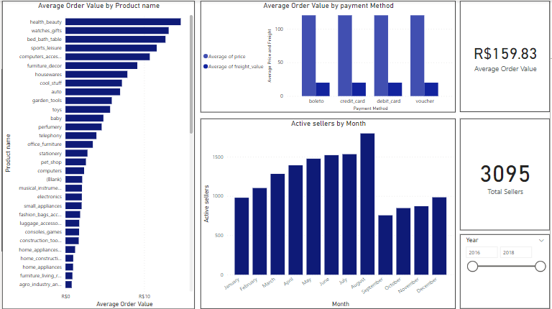
INSIGHTS:
The average order value was 159.83 Reals, with health_beauty, watches_gifts, and bed_bath_table being the top 3 product categories with the highest average order value.
Olist had 3095 active sellers from 2016 to 2018, with the number of active sellers growing significantly from January until August.
Note: The average order value was gotten from a division of the total order value and the total orders. The total order value is the sum of price and feight value of all products.

Slide 10
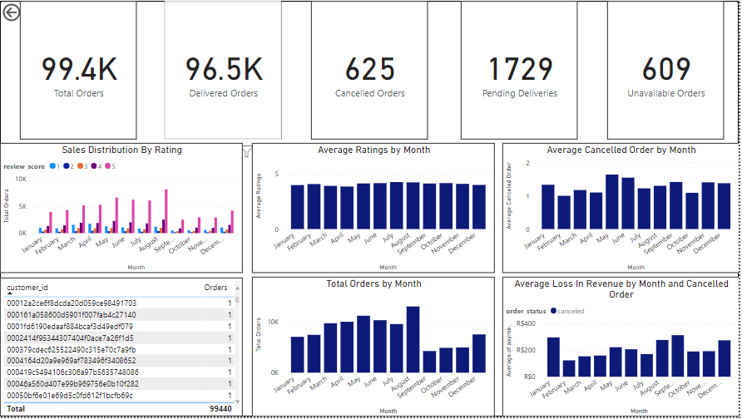
INSIGHTS:
Sellers with ratings of 4 and mainly 5 had the most sales, as seen in the distribution of seller ratings by months.
No repeat purchases were made by customers on Olist, according to the available dataset.
The average customer rating on Olist was 4, and it did not significantly impact the amount of products sold.
The average cancelled order on Olist was at least 1 per month, which did not have a significant impact on sellers' performance.

Slide 11
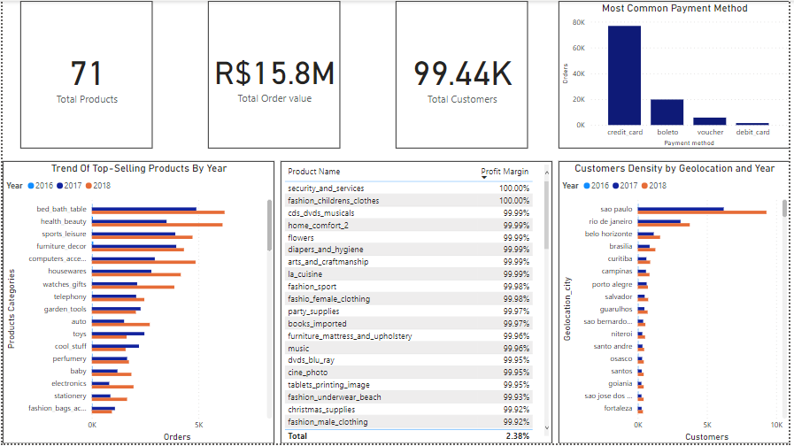
INSIGHTS:
Credit cards and boleto were the most preferred payment methods on Olist, which was consistent across payment categories and geolocation.
Customer reviews and ratings did not significantly impact product sales on Olist.
The products with the highest profit margins were security_and_services and fashion_children_clothes, and the company can increase its profitability across different categories by implementing discounts to products that are not selling well or reducing the quantity purchased for less profitable products.
No information was available in the dataset regarding Olist's marketing spend and channel mix.
Sao Paulo had the most customers among the geolocations, and customer retention and growth across geolocations were promising.

Slide 12
Recommendations
Increase marketing spend on product categories with low sales volumes:
Olist can allocate more marketing resources towards the product categories that have low sales volumes, in order to increase their visibility and sales.
Expand geographically:
Olist can expand to new geographic regions to increase their customer base and revenue.
Encourage repeat purchases:
Olist can implement strategies to encourage repeat purchases by offering loyalty programs or discounts to customers who make multiple purchases.
Improve seller performance:
Olist can work with sellers to improve their performance by providing training on how to effectively market and sell their products, and by providing better customer service.

